Slide 1
A Tale of Two Days
Brandon Ly
Brigham Young University
Ly.brandon.1000@gmail.com

Slide 2
why macro announcement days matter
CAPM says market beta should be sole determinant of excess returns
Historically, low beta stocks outperform high beta stocks ➔⬅
Frazzini & Pedersen (2014); Bates & Boyer (2020)
Does a high beta ever correspond with high excess returns?
If we can predict when this relationship will hold, we can time our BAB (betting against beta) strategy

Slide 3
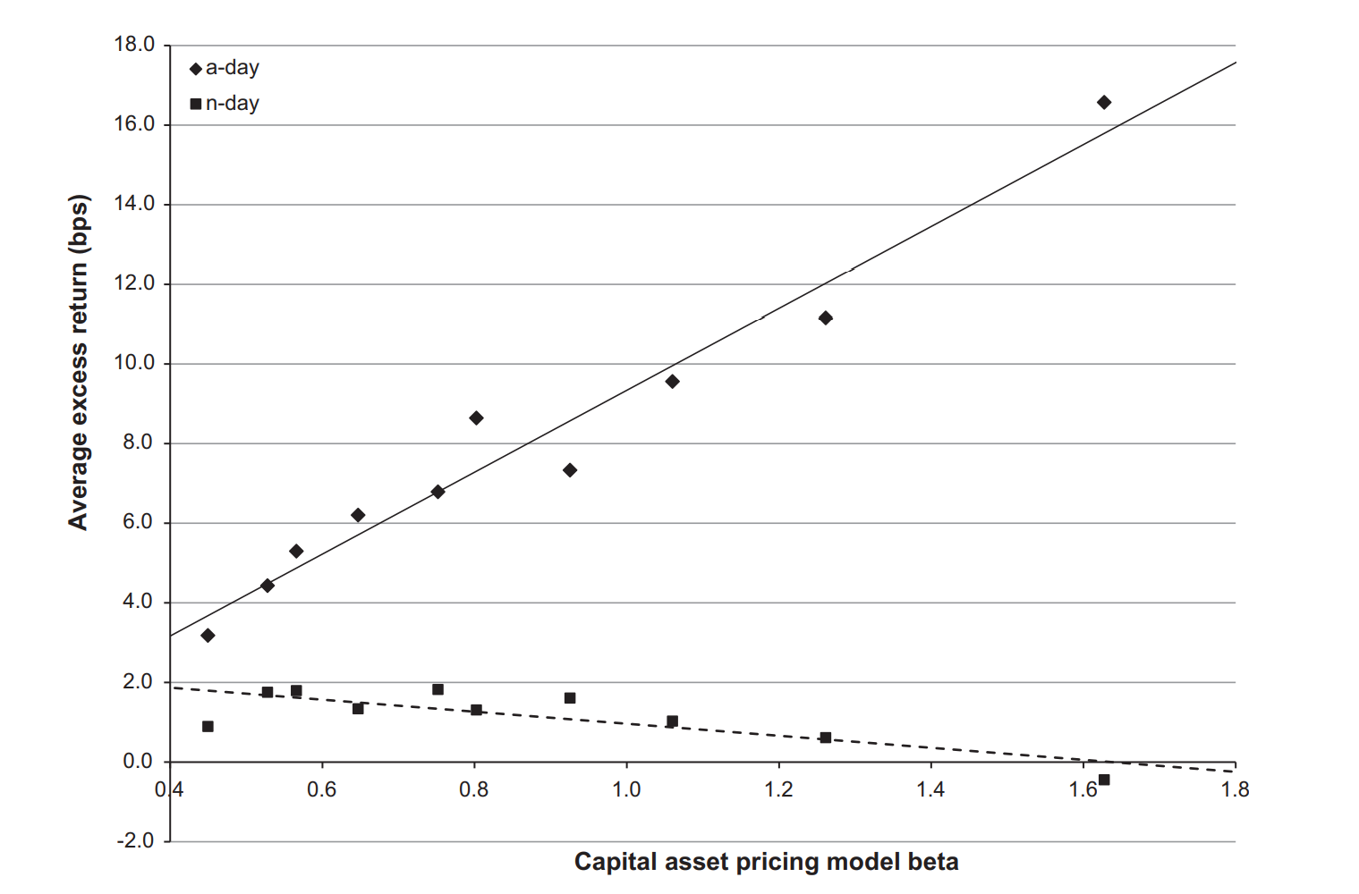
Motivation for subsetting announcement days (1964-2011)

Slide 4
Replicating beta-stock return relationships
Savor & Mungo (2013) split trading days into announcement days (a-days) and non-announcement days (n-days)
A-days: scheduled FOMC interest rate meetings, CPI/PPI announcements, and unemployment announcements
We use time series Fama-MacBeth regressions on stock portfolios & individual stocks:
Get lagged 1-year betas for all stocks across time
Sort stocks into 10 beta-decile portfolios (rebalanced monthly) across time
Calculate equal-weighted return on 10 portfolios across time
Get lagged 1-year betas for all 10 portfolios across time
Seperate data into a-days & n-days
Do F-M regressions of excess returns of test assets on beta of test assets

Slide 5
Beta-sorted portfolios

Slide 6
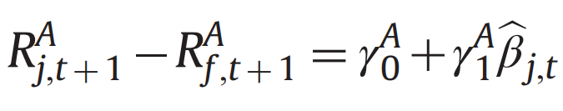
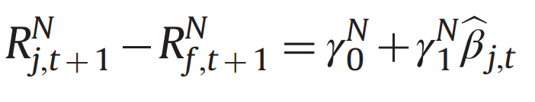
0 ≤ j ≤ 9
1/1/1964 ≤ t < 12/31/2011
Fama-MacBeth Regression
Ten beta-sorted portfolios (equal-weighted)
Type of day | γ0 | γ1
a-day | 0.06749 | 0.00094
 | [4.34]*** | [2.46]**
n-day | 0.09551 | -0.00034
 | [19.24]*** | [-2.96]***
a-day – n-day | -0.02802 | 0.00128
 | [-1.72]* | [3.21]***

Slide 7
0 ≤ j ≤ 44
1/1/1964 ≤ t < 12/31/2011
Fama-MacBeth Regression
Ten beta-sorted (equal-weighted), 25 Fama and French, and ten industry portfolios
Type of day | γ0 | γ1
a-day | 0.00452 | 0.00169
 | [4.88]*** | [5.02]***
n-day | 0.00618 | 0.00071
 | [20.58]*** | [6.68]***
a-day – n-day | -0.00166 | 0.00098
 | [-1.71]* | [2.78]***

Slide 8
Individual stocks

Slide 9
j ∈ J, J is all CRSP stocks
1/1/1964 ≤ t < 12/31/2011
Fama-MacBeth Regression
Excess returns for individual stocks regressed on their stock market betas
Type of day | γ1
a-day | 0.00059
 | [2.03]**
n-day | -0.00029
 | [-3.30]***
a-day – n-day | 0.00088
 | [2.90]***

Slide 10
j ∈ J, J is all CRSP stocks
1/1/1964 ≤ t < 12/31/2011
Fama-MacBeth Regression
Excess returns for individual stocks regressed on their stock maarket betas and size (SMB) , value (HML), and momentum (UMD) factor betas
Type of day | γ1 | γ2 | γ3 | γ4
a-day | 0.00042 | 0.00004 | -0.00011 | 0.00012
 | [0.97] | [0.23] | [-0.56] | [0.38]
n-day | -0.00032 | 0.00021 | -0.0001 | -0.00033
 | [-2.35]** | [3.69]*** | [-1.40] | [-3.41]***
a-day – n-day | 0.00073 | -0.00017 | -0.00001 | 0.00045
 | [1.63] | [-0.92] | [-0.05] | [1.33]

Slide 11
Oos test (2012 – 2019)
Fama-MacBeth Regression (2012-2019)
Ten beta-sorted portfolios (equal-weighted)
Type of day | γ0 | γ1
a-day | 0.05121 | 0.00047
 | [2.27]** | [0.66]
n-day | 0.0354 | -0.00002
 | [4.71]*** | [-0.09]
a-day – n-day | 0.01581 | 0.00049
 | [0.67] | [0.66]
Fama-MacBeth Regression (2012-2019)
Ten beta-sorted (equal-weighted), 25 Fama and French, and ten industry portfolios
Type of day | γ0 | γ1
a-day | 0.00329 | 0.0009
 | [2.17]** | [1.37]
n-day | 0.00237 | 0.00027
 | [4.77]*** | [1.23]
a-day – n-day | 0.00092 | 0.00063
 | [0.57] | [0.91]

Slide 12
Oos test (2012 – 2019)
Fama-MacBeth Regression
Excess returns for individual stocks regressed on their stock market betas
Type of day | γ1
a-day | 0.00063
 | [1.11]
n-day | 0.00003
 | [0.17]
a-day – n-day | 0.0006
 | [0.99]
Fama-MacBeth Regression
Excess returns for individual stocks regressed on their stock maarket betas and size (SMB) , value (HML), and momentum (UMD) factor betas
Type of day | γ1 | γ2 | γ3 | γ4
a-day | 0.00114 | -0.00048 | -0.00019 | -0.00091
 | [1.75]* | [-1.19] | [-0.57] | [-1.46]
n-day | -0.00009 | 0.00002 | 0.00003 | 0.00036
 | [-0.40] | [0.20] | [0.19] | [1.78]*
a-day – n-day | 0.00124 | -0.00051 | -0.00022 | -0.00127
 | [1.78]* | [-1.20] | [-0.60] | [-1.95]

Slide 13
conclusion
The high beta—high excess return relationship on a-days fails to hold out of sample (2012-2019)
It is still present but becomes statistically insignificant
Our results corroborate Savor & Mungo (2013) for the 1964-2011 time period
But fails to extend macro-announcements effect on beta’s predictive power for post-great recession period (2012-2019)
Try CPI instead of PPI (whichever date occurs first)?

Slide 14
Works Cited
Bates, B., & Boyer, B. (2020). Fundamentals of Investments. See pp. 255-6
Frazzini, A., & Heje Pedersen, L. (2014). Betting against Beta. Journal of Financial Economics, 111(1), 1-25. https://doi.org/10.1016/j.jfineco.2013.10.005
Savor, Pavel G. and Wilson, Mungo Ivor, Asset Pricing: A Tale of Two Days (August 2013). AFA 2013 San Diego Meetings Paper, Available at SSRN: https://ssrn.com/abstract=2024422 or http://dx.doi.org/10.2139/ssrn.2024422

